Slide 1

CMR INSTITUTE OF TECHNOLOGY:HYDERABAD Department of Computer Science and Engineering
CLASS:III- B.Tech V- SEMESTER
Regulation:R22
Course Code | Subject | POs | PSOs
22CSPC54 | Information and Cyber Security | 2,3,6,8,12 | 1
Course Outcomes (COs) & CO-PO Mapping (3-Strong; 2-Medium; 1-Weak Correlation)
COs | Upon completion of course the students will be able to | PO2 | PO3 | PO6 |  | PO8 |  | PO12 |  | PSO1
CO1 | Explain information and cyber security terminologies | 2 | 2 |  | 2 |  | 3 |  | 2 |  | 3
CO2 | Apply cryptography for security networks | 3 | 3 |  | 3 |  | 3 |  | 3 |  | 3
CO3 | Identify various cyber offences | 3 | 3 |  | 3 |  | 3 |  | 3 |  | 3
CO4 | Use standards and cyber laws to enhance cyber security | 3 | 3 |  | 3 |  | 3 |  | 3 |  | 3
C05 | IIlustrate the importance of security policies & IT Act | 3 | 3 |  | 3 |  | 3 |  | 3 |  | 3

Slide 2
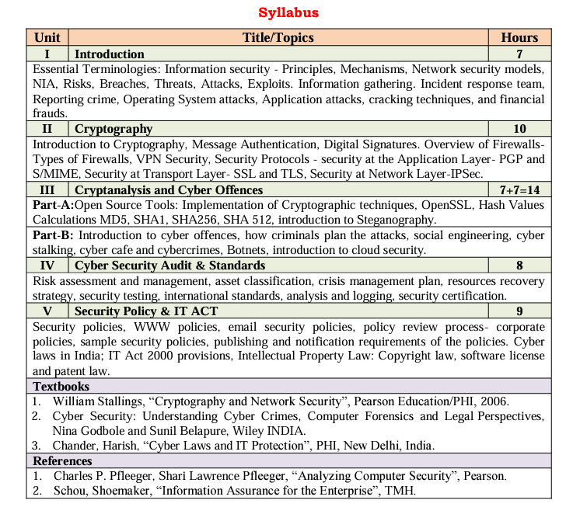

Slide 3
Introduction to Cryptography
Cryptography is a method of protecting information and communications through the use of codes, so that only those for whom the information is intended can read and process it.
Cryptography is the science of using mathematics to encrypt and decrypt data. Cryptography enables you to store sensitive information or transmit it across insecure networks (like the Internet) so that it cannot be read by anyone except the intended recipient.

Slide 4
Symmetric cryptography
Symmetric cryptography, known also as secret key cryptography, is the use of a single shared secret to share encrypted data between parties. Ciphers in this category are called symmetric because you use the same key to encrypt and to decrypt the data.
Some common symmetric key cryptography examples include the Advanced Encryption Standard (AES), the Data Encryption Standard (DES), along with IDEA, Blowfish, RC4 (Rivest Cipher 4), RC5 (Rivest Cipher 5), and RC6

Slide 5
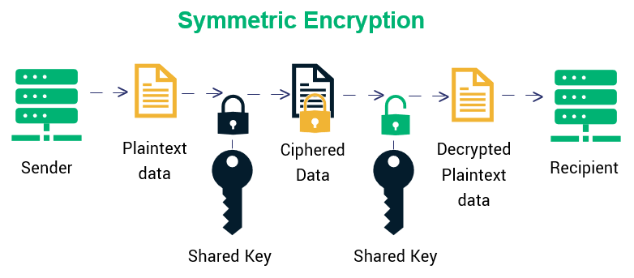

Slide 6
Asymmetric cryptography
Asymmetric cryptography, also known as public-key cryptography, is a process that uses a pair of related keys -- one public key and one private key -- to encrypt and decrypt a message and protect it from unauthorized access or use.
Examples of asymmetric encryption include: Rivest Shamir Adleman (RSA) the Digital Signature Standard (DSS), which incorporates the Digital Signature Algorithm (DSA) Elliptical Curve Cryptography (ECC)

Slide 7
Message authentication
Message authentication is another form of security. Similar to data encryption to ensure data confidentiality
Message authentication data security feature: Provides services to ensure the integrity of data for selected LU-LU sessions

Slide 8
Message Authentication Code (MAC)
MAC algorithm is a symmetric key cryptographic technique to provide message authentication. For establishing MAC process, the sender and receiver share a symmetric key K.
MAC is an encrypted checksum generated on the underlying message that is sent along with a message to ensure message authentication.
The process of using MAC for authentication is depicted in the following illustration −

Slide 9
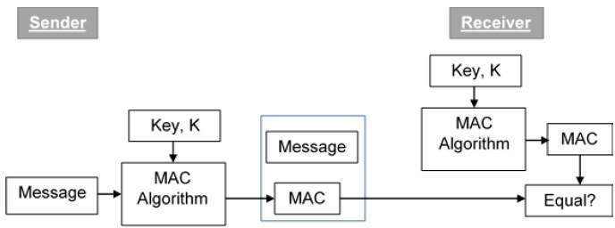
The sender uses some publicly known MAC algorithm, inputs the message and the secret key K and produces a MAC value.
Similar to hash, MAC function also compresses an random long input into a fixed length output. The major difference between hash and MAC is that MAC uses secret key during the compression.
The sender forwards the message along with the MAC. Here, we assume that the message is sent providing message origin authentication, not confidentiality. If confidentiality is required then the message needs encryption.
On receipt of the message and the MAC, the receiver feeds the received message and the shared secret key K into the MAC algorithm and re-computes the MAC value.
The receiver now checks equality of freshly computed MAC with the MAC received from the sender. If they match, then the receiver accepts the message and assures himself that the message has been sent by the intended sender.
If the computed MAC does not match the MAC sent by the sender, the receiver cannot determine whether it is the message that has been altered or it is the origin that has been falsified. As a bottom-line, a receiver safely assumes that the message is not the genuine.

Slide 10
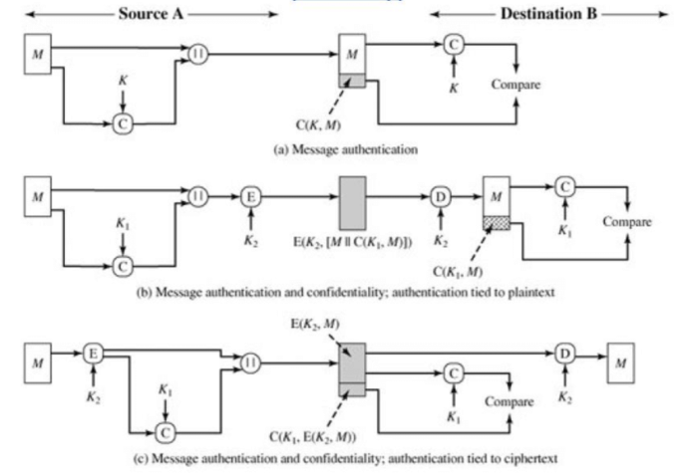

Slide 11
There are two methods for producing the message authentication code:
Data encryption standard (DES) product that requires a cryptographic product to be active. Using this method, both cryptography and message authentication can be performed concurrently. Although the keyword is DES, if the session is setup to use triple-DES encryption, TDES24 will be used.
Cyclic redundancy check (CRC), which creates a message authentication code using an internal VTAM algorithm. Using this method does not require a cryptography product to be active.

Slide 12
Digital Signatures
Digital signatures are the public-key primitives of message authentication. In the physical world, it is common to use handwritten signatures on handwritten or typed messages. They are used to bind signatory to the message.
Similarly, a digital signature is a technique that binds a person/entity to the digital data. This binding can be independently verified by receiver as well as any third party.
Digital signature is a cryptographic value that is calculated from the data and a secret key known only by the signer.
Model of Digital Signature
The digital signature scheme is based on public key cryptography. The model of digital signature scheme is depicted in the following illustration −

Slide 13
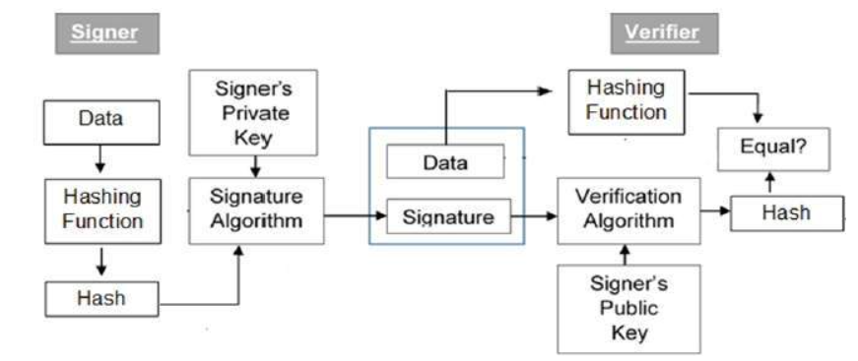

Slide 14
The following points explain the entire process in detail −
Each person adopting this scheme has a public-private key pair.
Generally, the key pairs used for encryption/decryption and signing/verifying are different. The private key used for signing is referred to as the signature key and the public key as the verification key.
Signer feeds data to the hash function and generates hash of data.
Hash value and signature key are then fed to the signature algorithm which produces the digital signature on given hash. Signature is appended to the data and then both are sent to the verifier.

Slide 15
Verifier feeds the digital signature and the verification key into the verification algorithm. The verification algorithm gives some value as output.
Verifier also runs same hash function on received data to generate hash value.
For verification, this hash value and output of verification algorithm are compared. Based on the comparison result, verifier decides whether the digital signature is valid.
Since digital signature is created by ‘private’ key of signer and no one else can have this key; the signer cannot repudiate signing the data in future.

Slide 16
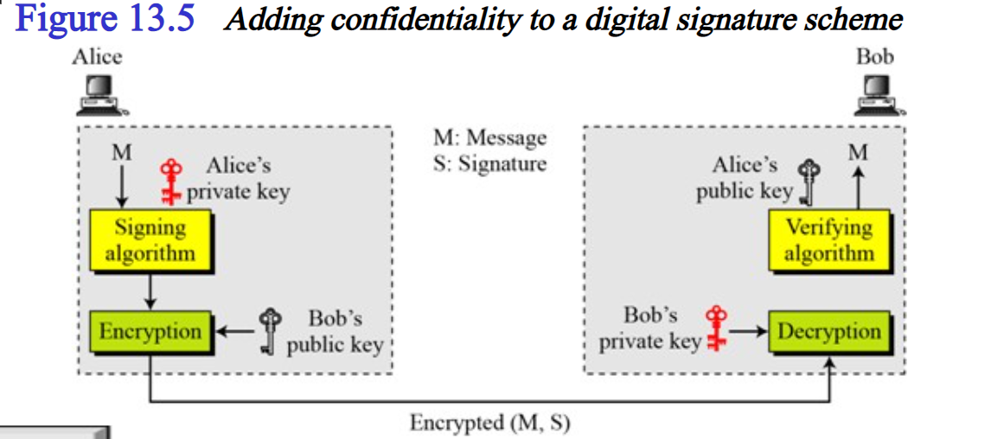

Slide 17
Importance of Digital Signature
Out of all cryptographic primitives, the digital signature using public key cryptography is considered as very important and useful tool to achieve information security.
Apart from ability to provide non-repudiation of message, the digital signature also provides message authentication and data integrity. Let us briefly see how this is achieved by the digital signature −
Message authentication − When the verifier validates the digital signature using public key of a sender, he is assured that signature has been created only by sender who possess the corresponding secret private key and no one else.

Slide 18
Data Integrity − In case an attacker has access to the data and modifies it, the digital signature verification at receiver end fails. The hash of modified data and the output provided by the verification algorithm will not match. Hence, receiver can safely deny the message assuming that data integrity has been breached.
Non-repudiation − Since it is assumed that only the signer has the knowledge of the signature key, he can only create unique signature on a given data. Thus the receiver can present data and the digital signature to a third party as evidence if any dispute arises in the future.

Slide 19
Overview of Firewalls

Slide 20
What is firewall
A Firewall is a network security device that monitors and filters incoming and outgoing network traffic based on an organization’s previously established security policies
A firewall is essentially the barrier that sits between a private internal network and the public Internet.
A firewall’s main purpose is to allow non-threatening traffic in and to keep dangerous traffic out.

Slide 21
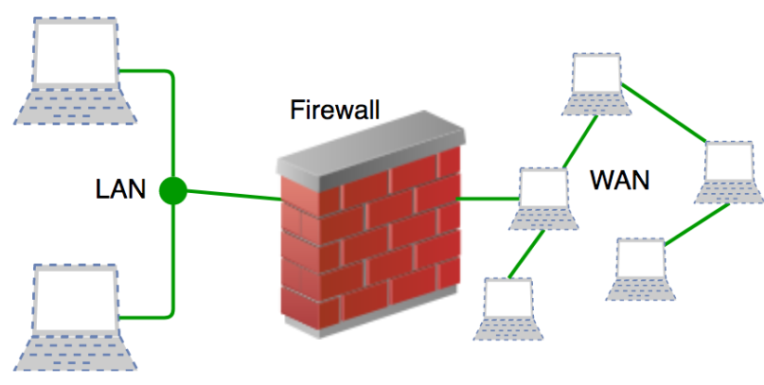

Slide 22
History
Firewalls have existed since the late 1980’s and started out as packet filters, which were networks set up to examine packets, or bytes, transferred between computers.
Packet filtering firewalls are still in use today, firewalls have come a long way as technology has developed throughout the decades.

Slide 23
Gen 1 Virus
Generation 1, Late 1980’s, virus attacks on stand-alone PC’s affected all businesses and group anti-virus products.
Gen 2 Networks
Generation 2, Mid 1990’s, attacks from the internet affected all business and drove creation of the firewall.
Gen 3 Applications
Generation 3, Early 2000’s, exploiting vulnerabilities in applications which affected most businesses and set Intrusion Prevention Systems Products (IPS).
Gen 4 Payload
Generation 4, Approx. 2010, rise of targeted, unknown, evasive, polymorphic attacks which affected most businesses and drove anti-bot and sandboxing products.
Gen 5 Mega
Generation 5, Approx. 2017, large scale, multi-vector, mega attacks using advance attack tools and is driving advance threat prevention solutions.

Slide 24
First-Generation Vs Modern Firewalls
Expanded Capabilities:
Next-generation firewalls (NGFWs) are sophisticated and integrate a number of network security components, including intrusion prevention systems (IPS), sandbox content analysis, and more.
It enables them to detect and respond to a greater range of potential threats.
Multiple Deployment Options:
Firewalls as either hardware firewalls – standalone appliances running on dedicated hardware .
OS software firewalls like those integrated into Windows, Linux, and macOS.
Modern firewalls are available in a variety of different form factors, enabling users to deploy them on-premises as physical appliances,
In the cloud as virtual appliances and as a firewall as a service (FWaaS) model.

Slide 25
What Firewalls Do?
A Firewall is a necessary part of any security architecture and takes the estimation out of host level protections and entrusts them to your network security device.
Firewalls, and especially Next Generation Firewalls, focus on blocking malware and application-layer attacks, along with an integrated intrusion prevention system (IPS)
Next Generation Firewalls can react quickly and to detect and react to outside attacks across the whole network.
Set policies to better defend your network and carry out quick assessments to detect offensive or suspicious activity, like malware, and shut it down.

Slide 26
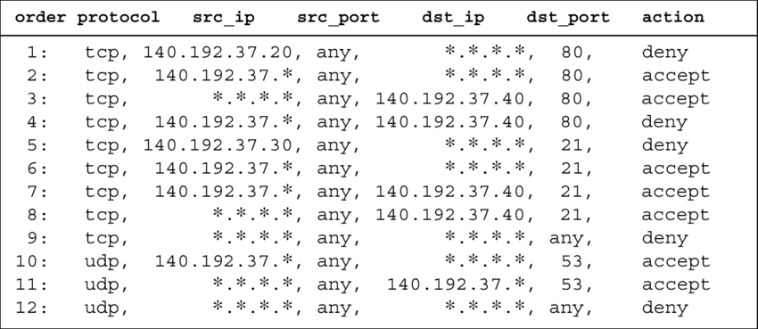
A firewall policy example.
Notes:
https://help.deepsecurity.trendmicro.com/10/0/Protection-Modules/Firewall/create-firewall-rules.html

Slide 27
Functions and Capabilities
Today’s firewalls, including Next Generation Firewalls and Network Firewalls support a wide variety of functions and capabilities with built-in features, including:
Network Threat Prevention
Application and Identity-Based Control
Hybrid Cloud Support
Scalable Performance
Network Traffic Management and Control
Access Validation
Record and Report on Events

Slide 28
What are the Components of Firewall Management?
Graphical Interface.
Policy Control
Threat Management
Device Management
Third-Party Integrations
Scalability

Slide 29
Types of Firewalls
Packet filtering
A small amount of data is analyzed and distributed according to the filter’s standards.
Proxy service or Circuit level Gateway
Network security system that protects while filtering messages at the application layer.
Application level Gateway
It operates at the application level. Multiple application gateways can run on the same host but each gateway is a separate server with its own processes.
Stateful inspection
Dynamic packet filtering that monitors active connections to determine which network packets to allow through the Firewall.
Next Generation Firewall (NGFW)
Deep packet inspection Firewall with application-level inspection.

Slide 30
Packet-filtering firewalls
Packet-filtering firewalls operate at the network layer . Packet-filtering firewalls make processing decisions based on network addresses, ports, or protocols.
Packet-filtering firewalls are very fast
Do not do any internal inspection of the traffic.
Do not store any state information.
Packet-filtering firewalls are considered not to be very secure. This is because they will forward any traffic that is flowing on an approved port.
So there could be malicious traffic being sent, but as long as it’s on an acceptable port, it will not be blocked.

Slide 31
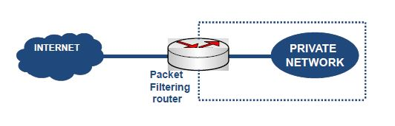

Slide 32
Proxy service
A proxy firewall is a network security system that protects network resources by filtering messages at the application layer.
A proxy firewall is also be called an application firewall or circuit level gateway firewall.
A proxy firewall is also a proxy server, but not all proxy servers are proxy firewalls. A proxy server acts as an intermediary between clients and servers. It can cache WebPages to reduce bandwidth demands, compress data, filter traffic and detect viruses.
A Proxy server can also be used to hide user information or to connect to services that would be blocked.
A proxy firewall inspects all network traffic to detect and protect against potential threats.
It can also detect network intrusion and enforce security policies.

Slide 33
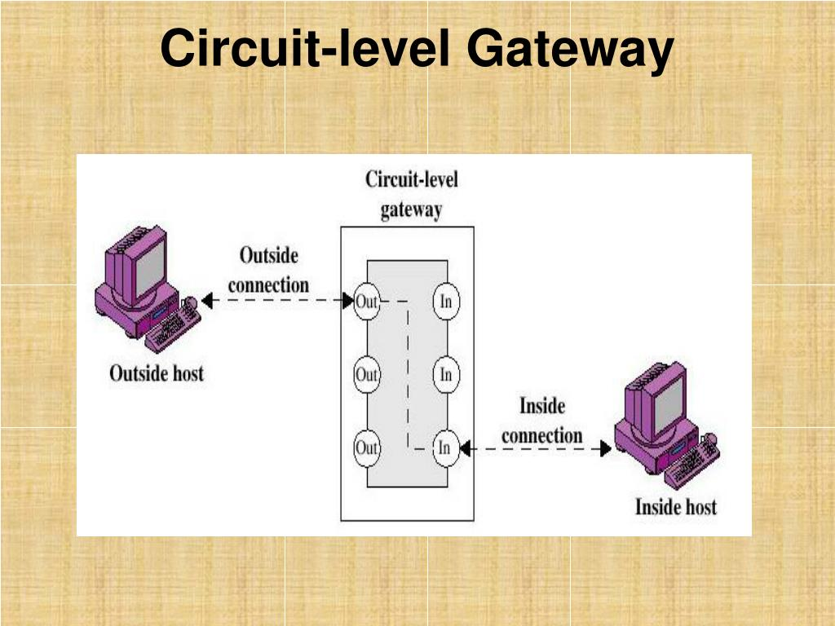

Slide 34
Application level Gateway
Application-level gateway is also called a bastion host. It operates at the application level. Multiple application gateways can run on the same host but each gateway is a separate server with its own processes.
These firewalls, also known as application proxies, provide the most secure type of data connection because they can examine every layer of the communication, including the application data.
Example: Consider FTP service.
It works as follows:
Step-1: User contacts the application gateway using a TCP/IP application such as HTTP.
Step-2: The application gateway asks about the remote host with which the user wants to establish a connection. It also asks for the user id and password that is required to access the services of the application gateway.
Step-3: After verifying the authenticity of the user, the application gateway accesses the remote host on behalf of the user to deliver the packets.

Slide 35
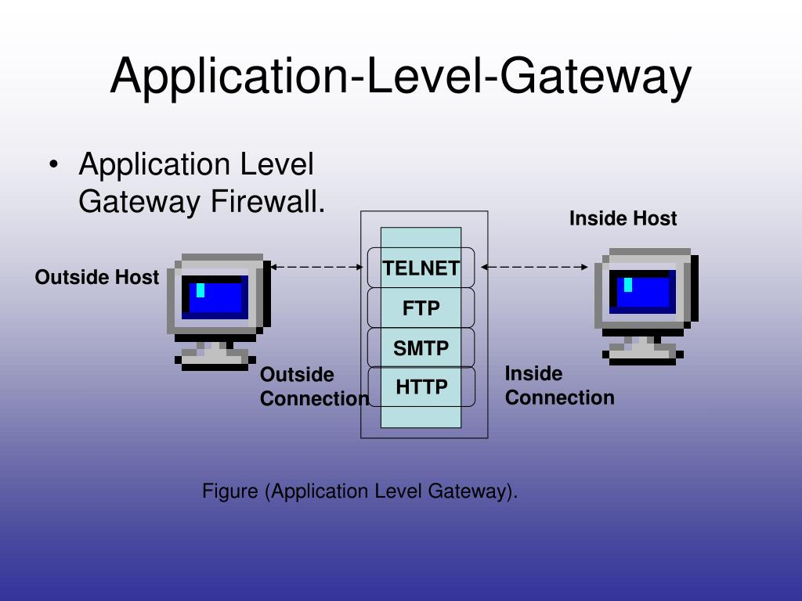

Slide 36
Stateful inspection
Stateful Inspection Firewall – a technology that controls the flow of traffic between two or more networks.
SI Firewalls track the state of sessions and dropping packets that are not part of a session allowed by a pre-defined security policy.
This is sometimes called session-level protection because they keep state information for each network session and make allowed/denied decisions based on a session state table.
SI firewalls go beyond individual transmission control protocol (TCP) connections to involve many such connections.
SI firewalls support dynamic protocols by identifying port change instructions in client-server communication and comparing future sessions against these negotiated ports.
For instance, to track fire transfer protocol (FTP) sessions, the firewall inspects the control connection, used for issuing commands and negotiating dynamic ports, and then allows in various data connections for transferring files.

Slide 37
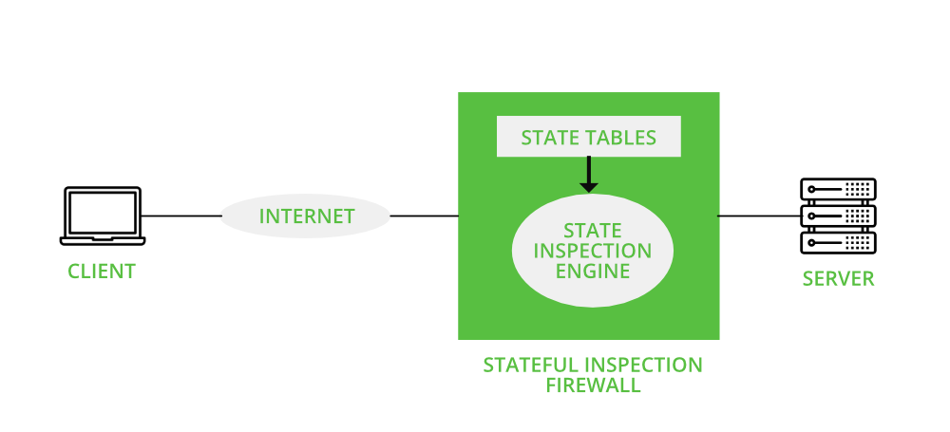

Slide 38
What is Firewall Software?
The two main ways to deploy a firewall are as firewall software running as an application on a host or as a hardware firewall running on a dedicated network device.
Firewall software is widely used on personal and company laptops running Windows, macOS, and other Unix-like operating systems.

Slide 39
How Does a Hardware Firewall Work?
A network security solution, a hardware firewall is designed to protect an organization’s network boundary by being deployed in inline mode.
This means that the physical network cables over which traffic can cross this boundary are connected to ports on the “inside” and “outside” of the firewall.
When traffic enters a network firewall, it is subjected to security inspection and may have multiple different controls applied to it.
At a high level, firewalls commonly are configured to block certain types of traffic from crossing the network boundary.
This can help to block traffic over any unused or undesirable ports from entering the network and to stop certain types of traffic from leaving the network (such as traffic that could leak sensitive data)

Slide 40
What is VPN
A VPN provides a secure, encrypted connection between two points. Before setting up the VPN connection, the two endpoints of the connection create a shared encryption key. This can be accomplished by providing a user with a password or using a key sharing algorithm.
Once the key has been shared, it can be used to encrypt all traffic flowing over the VPN link.
For example, a client machine will encrypt data and send it to the other VPN endpoint. At this location, the data will be decrypted and forwarded on to its destination. When the destination server sends a response, the entire process will be completed.

Slide 41
The Importance of NAT and VPN
Firewalls also perform basic network level functions such as Network Address Translation (NAT) and Virtual Private Network (VPN).
Network Address Translation hides or translates internal client or server IP addresses that may be in a “private address range”
Hiding the addresses of protected devices preserves the limited number of IPv4 addresses and is a defense against network inspection since the IP address is hidden from the Internet.
Similarly, a virtual private network (VPN) extends a private network across a public network within a tunnel that is often encrypted where the contents of the packets are protected while traversing the Internet.
This enables users to safely send and receive data across shared or public networks.

Slide 42
Security protocols
It is also called cryptographic protocol, it constitutes transferring specially constructed encrypted messages between legitimate protocol participants to fulfill objectives such as mutual authentication or key-exchange in a predefined procedure
A security protocol is essentially a communication protocol – an agreed sequence of actions performed by two or more communicating entities in order to accomplish some mutually desirable goal – that makes use of cryptographic techniques, allowing the communicating entities to achieve a security goal.

Slide 43
Types of Security Protocols
IPSec and VPNs
SSL and TLS
Application Transparent Transport Layer Security
Kerberos
OSPF authentication
SNMPv3

Slide 44
IPSec and VPNs
It provides authentication, integrity, and data privacy between any two IP entities.
With IPSec, you can create virtual private networks (VPN). A VPN enables an enterprise to extend its private network across a public network, such as the Internet, through a secure tunnel called a security association.
IPSec VPNs enable the secure transfer of data over the public Internet for same-business and business-to-business communications, and protect sensitive data within the enterprise's internal network.

Slide 45
SSL and TLS
The SSL protocol provides data encryption, data origin authentication, and message integrity
It also provides server and client authentication using X.509 certificates.
SSL begins with a handshake during which the server is authenticated to the client using X.509 certificates.
Also, the client can optionally be authenticated to the server.
During the handshake, security session parameters, such as cryptographic algorithms, are negotiated and session keys are created.
After the handshake, the data is protected during transmission with data origin authentication and optional encryption using the session keys.

Slide 46
Application Transparent Transport Layer Security (AT-TLS)
Application Transparent Transport Layer Security (AT-TLS) creates a secure session on behalf of an application.
Instead of implementing TLS in every application that requires a secure connection, AT-TLS provides encryption and decryption of data based on policy statements that are coded in the Policy Agent.
The application sends and receives cleartext (unencrypted data) as usual while AT-TLS encrypts and decrypts data at the TCP transport layer.

Slide 47
Kerberos
Kerberos is a third-party network authentication protocol that employs a system of shared secret keys to securely authenticate a user in an unsecured network environment.
Kerberos authentication is managed by a three-tiered system in which encrypted service tickets, rather than a plain-text user ID and password pair, are exchanged between the application server and client.
These encrypted service tickets, called credentials, are provided by a separate server called the Kerberos Key Distribution Center (KDC)

Slide 48
OSPF Authentication
Communications Server OSPF (Open Shortest Path First) dynamic routing protocol supports message authentication and message integrity of OSPF routing messages through the use of the OSPF MD5 Authentication security protocol as defined by RFC 2328.
OSPF MD5 Authentication ensures that an unauthorized IP resource cannot inject OSPF routing messages into the network without detection, thus ensuring the integrity of the routing tables in the OSPF routing network. OMPROUTE computes a secure MAC for the routing message using the MD5 algorithm.

Slide 49
SNMPv3
SNMPv3 delivers a powerful and flexible framework for message security and access control.
Message security involves provides Data integrity checking to ensure that the data was not altered in transit.
Data origin verification to ensure that the request or response originates from the source that it claims to have come from.
Message timeliness checking and, optionally, data confidentiality to protect against eavesdropping.

Slide 50
Security at the Application Layer
Application layer security refers to ways of protecting web applications at the application layer (layer 7 of the OSI model) from malicious attacks.
Since the application layer is the closest layer to the end user, it provides hackers with the largest threat surface.

Slide 51
Various business services are now offered online though client-server applications.
The most popular forms are web application and e-mail
While using a service from any server application, the client and server exchange a lot of information on the underlying intranet or Internet. We are aware of fact that these information transactions are vulnerable to various attacks.
Network security requires securing data against attacks while it is in transit on a network. To achieve this goal, many real-time security protocols have been designed. Such protocol needs to provide at least the following primary objectives −
1. The parties can negotiate interactively to authenticate each other.
2.Establish a secret session key before exchanging information on network.
3. Exchange the information in encrypted form.

Slide 52
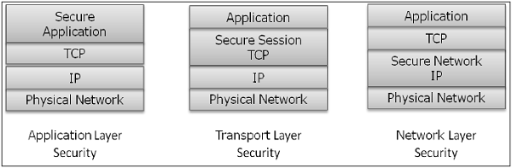
Interestingly, these protocols work at different layers of networking model.
For example,
-S/MIME protocol works at Application layer,
-SSL protocol is developed to work at transport layer, and
-IPsec protocol works at Network layer.

Slide 53
In this topic, we will discuss different processes for achieving security for e-mail communication and associated security protocols..

Slide 54
E-mail Security
Nowadays, e-mail has become very widely used network application. Let’s briefly discuss the e-mail infrastructure before proceeding to know about e-mail security protocols.
E-mail Infrastructure
The simplest way of sending an e-mail would be sending a message directly from the sender’s machine to the recipient’s machine.
In this case, it is essential for both the machines to be running on the network simultaneously. However, this setup is impractical as users may occasionally connect their machines to the network.

Slide 55
Hence, the concept of setting up e-mail servers arrived. In this setup, the mail is sent to a mail server which is permanently available on the network. When the recipient’s machine connects to the network, it reads the mail from the mail server.
In general, the e-mail infrastructure consists of a mesh of mail servers, also termed as Message Transfer Agents (MTAs) and client machines running an e-mail program comprising of User Agent (UA) and local MTA.
Typically, an e-mail message gets forwarded from its UA, goes through the mesh of MTAs and finally reaches the UA on the recipient’s machine.

Slide 56
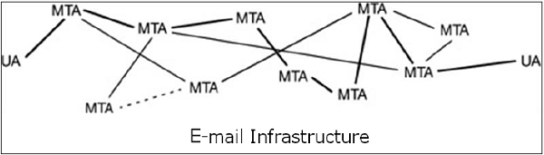
The protocols used for e-mail are as follows −
--->Simple mail Transfer Protocol (SMTP) used for forwarding e-
mail messages.
--->Post Office Protocol (POP) and Internet Message Access
Protocol (IMAP) are used to retrieve the messages
by recipient from the server.

Slide 57
E-Mail Security Services
Growing use of e-mail communication for important and crucial transactions demands provision of certain fundamental security services as the following −
Confidentiality − E-mail message should not be read by anyone but the intended recipient.
Authentication − E-mail recipient can be sure of the identity of the sender.
Integrity − Assurance to the recipient that the e-mail message has not been altered since it was transmitted by the sender.
Non-repudiation − E-mail recipient is able to prove to a third party that the sender really did send the message.
Proof of submission − E-mail sender gets the confirmation that the message is handed to the mail delivery system.
Proof of delivery − Sender gets a confirmation that the recipient received the message.

Slide 58
Security services such as privacy, authentication, message integrity, and non-repudiation are usually provided by using public key cryptography. Typically, there are three different scenarios of e-mail communication. We will discuss the methods of achieving above security services in these scenarios. One-to-One E-mail One-to-Multiple Recipients E-mail One-to-Distribution List E-mail

Slide 59
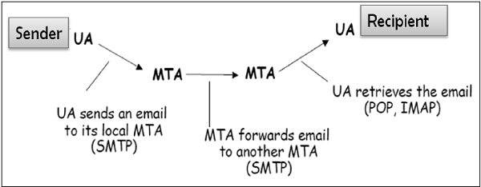
One-to-One E-mail
In this scenario, the sender sends an e-mail message to only one recipient. Usually, not more than two MTA are involved in the communication.
Let’s assume a sender wants to send a confidential e-mail to a recipient. The provision of privacy in this case is achieved as follows −
The sender and receiver have their private-public keys as (S_{PVT}, S_{PUB}) and (R_{PVT}, R_{PUB}) respectively.
The sender generates a secret symmetric key, K_{S} for encryption. Though the sender could have used R_{PUB} for encryption, a symmetric key is used to achieve faster encryption and decryption.
The sender encrypts message with key K_{S} and also encrypts K_{S} with public key of the recipient, R_{PUB}.
The sender sends encrypted message and encrypted K_{S} to the recipient.
The recipient first obtains K_{S} by decrypting encoded K_{S} using his private key, R_{PVT}.
The recipient then decrypts message using the symmetric key, K_{S}.

Slide 60
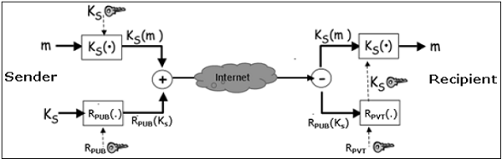
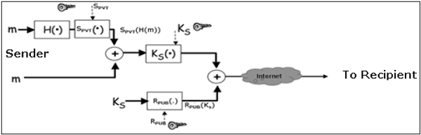
If message integrity, authentication, and non-repudiation services are also needed in this scenario, the following steps are added to the above process.
The sender produces hash of message and digitally signs this hash with his private key, S_{PVT}.
The sender sends this signed hash to the recipient along with other components.
The recipient uses public key S_{PUB} and extracts the hash received under the sender’s signature.
The recipient then hashes the decrypted message and now compares the two hash values. If they match, message integrity is considered to be achieved.
Also, the recipient is sure that the message is sent by the sender (authentication). And lastly, the sender cannot deny that he did not send the message (non-repudiation

Slide 61
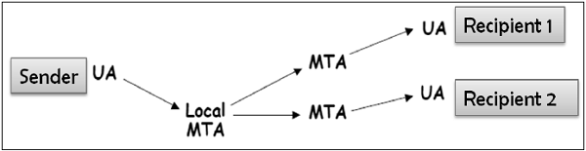
One-to-Multiple Recipients E-mail
In this scenario, the sender sends an e-mail message to two or more recipients. The list is managed by the sender’s e-mail program (UA + local MTA). All recipients get the same message.
Let’s assume, the sender wants to send confidential e-mail to many recipients (say R1, R2, and R3). The provision of privacy in this case is achieved as follows −
The sender and all recipients have their own pair of private-public keys.
The sender generates a secret symmetric key, K_{s} and encrypts the message with this key.
The sender then encrypts K_{S} multiple times with public keys of R1, R2, and R3, getting R1_{PUB}(K_{S}), R2_{PUB}(K_{S}), and R3_{PUB}(K_{S}).
The sender sends encrypted message and corresponding encrypted K_{S} to the recipient. For example, recipient 1 (R1) receives encrypted message and R1_{PUB}(K_{S}).
Each recipient first extracts key K_{S} by decrypting encoded K_{S} using his private key.
Each recipient then decrypts the message using the symmetric key, K_{S}.
For providing the message integrity, authentication, and non-repudiation, the steps to be followed are similar to the steps mentioned above in one-to-one e-mail scenario.

Slide 62
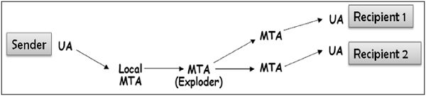
One-to-Distribution List E-mail
In this scenario, the sender sends an e-mail message to two or more recipients but the list of recipients is not managed locally by the sender. Generally, the e-mail server (MTA) maintains the mailing list.
The sender sends a mail to the MTA managing the mailing list and then the mail is exploded by MTA to all recipients in the list.

Slide 63
In this case, when the sender wants to send a confidential e-mail to the recipients of the mailing list (say R1, R2, and R3); the privacy is ensured as follows −
The sender and all recipients have their own pair of private-public keys. The Exploder Server has a pair of private-public key for each mailing list (List_{PUB}, List_{PVT}) maintained by it.
The sender generates a secret symmetric key K_{s} and then encrypts the message with this key.
The sender then encrypts K_{S} with the public key associated with the list, obtains List_{PUB}(K_{S}).
The sender sends encrypted message and List_{PUB}(K_{S}). The exploder MTA decrypts List_{PUB}(K_{S}) using List_{PVT} and obtains K_{S}.
The exploder encrypts K_{S} with as many public keys as there are members in the list.
The Exploder forwards the received encrypted message and corresponding encrypted K_{S} to all recipients in the list. For example, the Exploder forwards the encrypted message and R1_{PUB}(K_{S}) to recipient 1 and so on.

Slide 64
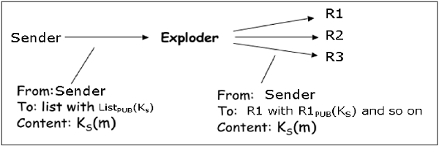
For providing the message integrity, authentication, and non-repudiation the steps to be followed are similar as given in case of one-to-one e-mail scenario.
Interestingly, the e-mail program employing above security to work for method for securing e-mail is expected all the possible scenarios discussed above. Most of the above security mechanisms for e-mail are provided by two popular schemes, Pretty Good Privacy (PGP) and S/MIME. We discuss both in the following sections.

Slide 65
MIME
Basic Internet e-mail standard was written in 1982 and it describes the format of e-mail message exchanged on the Internet.
It mainly supports e-mail message written as text in basic Roman alphabet.
By 1992, the need was felt to improve the same. Hence, an additional standard Multipurpose Internet Mail Extensions (MIME) was defined.
It is a set of extensions to the basic Internet E-mail standard.
MIME provides an ability to send e-mail using characters other than those of the basic Roman alphabet such as Cyrillic alphabet (used in Russian), the Greek alphabet, or even the ideographic characters of Chinese
Another need fulfilled by MIME is to send non-text contents, such as images or video clips. Due to this features, the MIME standard became widely adopted with SMTP for e-mail communication.

Slide 66
Secure/Multipurpose Internet Mail Extension (S/MIME) is an industry-standard for email encryption and signature that is commonly used by businesses to improve email security. S/MIME is supported by the majority of corporate email clients.
S/MIME encrypts and digitally signs emails to verify that they are verified and that their contents have not been tampered with.

Slide 67
Pretty Good Privacy (PGP)
Pretty Good Privacy (PGP) is an e-mail encryption scheme. It has become the de-facto standard for providing security services for e-mail communication.
As discussed above, it uses public key cryptography, symmetric key cryptography, hash function, and digital signature. It provides −
Privacy
Sender Authentication
Message Integrity
Non-repudiation
Along with these security services, it also provides data compression and key management support. PGP uses existing cryptographic algorithms such as RSA, IDEA, MD5, etc., rather than inventing the new ones

Slide 68
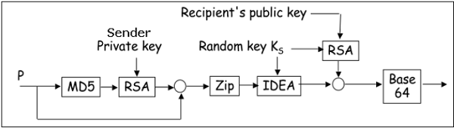
Working of PGP
--Hash of the message is calculated. (MD5 algorithm)
---Resultant 128 bit hash is signed using the private key of the sender (RSA
Algorithm).
---The digital signature is concatenated to message, and the result is
compressed.
---A 128-bit symmetric key, K_{S} is generated and used to encrypt the
compressed message with IDEA.
---K_{S} is encrypted using the public key of the recipient using RSA algorithm and
the result is appended to the encrypted message.

Slide 69
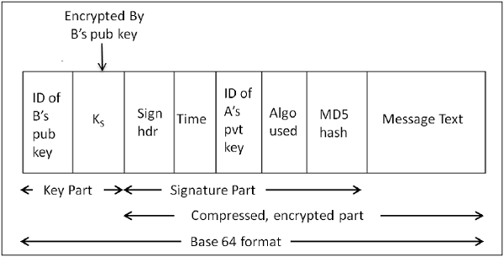
The format of PGP message is shown in the following diagram. The IDs indicate which key is used to encrypt KS and which key is to be used to verify the signature on the hash.
In PGP scheme, a message in signed and encrypted, and then MIME is encoded before transmission.

Slide 70
PGP | S/MIME
PGP stands for Pretty Good Privacy. | S/MIME stands for Secure/Multipurpose Internet Mail Extension.
It can be used by individuals and corporations. | It is used by corporations or for commercial purposes.
PGP is a general purpose application to protect files and used for email security. | S/MIME is used for email security.
Diffie Hellman digital signature is used. | Elgamal digital signature is used.
PGP is a data encryption and decryption computer program that offers cryptographic privacy and authentication for internet data transmission. | S/MIME provides the authentication, message integrity and non-repudiation of origin and data security services for electronic data transmission applications.
PGP was designed to eliminate security issues of text messages. | S/MIME was designed to provide security for attachments and data files.
PGP products are costlier than S/MIME. | S/MIME products are cheaper than PGP.

Slide 71
Transport layer
Transport Layer is the second layer in the TCP/IP model and the fourth layer in the OSI model.
It is an end-to-end layer used to deliver messages to a host.
It is termed an end-to-end layer because it provides a point-to-point connection rather than hop-to- hop, between the source host and destination host to deliver the services reliably.

Slide 72
Working of Transport Layer:
The transport layer takes services from the Network layer and provides services to the Application layer
At the sender’s side: The transport layer receives data (message) from the Application layer and then performs Segmentation, divides the actual message into segments, adds source and destination’s port numbers into the header of the segment, and transfers the message to the Network layer.
At the receiver’s side: The transport layer receives data from the Network layer, reassembles the segmented data, reads its header, identifies the port number, and forwards the message to the appropriate port in the Application layer.

Slide 73
Responsibilities of a Transport Layer:
Process to process delivery
End-to-end Connection between hosts
Multiplexing and Demultiplexing
Congestion Control
Data integrity and Error correction
Flow control

Slide 74
Protocols of Transport Layer
TCP(Transmission Control Protocol)
UDP (User Datagram Protocol)
SCTP (Stream Control Transmission Protocol)
DCCP (Datagram Congestion Control Protocol)
ATP (AppleTalk Transaction Protocol)
FCP (Fibre Channel Protocol)
RDP (Reliable Data Protocol)
RUDP (Reliable User Data Protocol)
SST (Structured Steam Transport)
SPX (Sequenced Packet Exchange)

Slide 75
security at the Transport layer
Network security involves securing data against attacks while it is in transit on a network. To achieve this goal, many real-time security protocols have been designed.
There are popular standards for real-time network security protocols such as S/MIME, SSL/TLS, SSH, and IPsec. As mentioned earlier, these protocols work at different layers of networking model.
In the last topic, we discussed some popular protocols that are designed to provide application layer security. In this chapter, we will discuss the process of achieving network security at Transport Layer and associated security protocols.
For TCP/IP protocol based network, physical and data link layers are typically implemented in the user terminal and network card hardware. TCP and IP layers are implemented in the operating system. Anything above TCP/IP is implemented as user process.

Slide 76
Need for Transport Layer Security
Let's discuss a typical Internet-based business transaction.
Bob visits Alice’s website for selling goods. In a form on the website, Bob enters the type of good and quantity desired, his address and payment card details. Bob clicks on Submit and waits for delivery of goods with debit of price amount from his account. All this sounds good, but in absence of network security, Bob could be in for a few surprises.
If transactions did not use confidentiality (encryption), an attacker could obtain his payment card information. The attacker can then make purchases at Bob's expense.
If no data integrity measure is used, an attacker could modify Bob's order in terms of type or quantity of goods.

Slide 77
Lastly, if no server authentication is used, a server could display Alice's famous logo but the site could be a malicious site maintained by an attacker, who is masquerading as Alice. After receiving Bob's order, he could take Bob's money and flee. Or he could carry out an identity theft by collecting Bob's name and credit card details.
Transport layer security schemes can address these problems by enhancing TCP/IP based network communication with confidentiality, data integrity, server authentication, and client authentication.
The security at this layer is mostly used to secure HTTP based web transactions on a network. However, it can be employed by any application running over TCP.

Slide 78
Philosophy of TLS Design
Transport Layer Security (TLS) protocols operate above the TCP layer.
Design of these protocols use popular Application Program Interfaces (API) to TCP, called “sockets" for interfacing with TCP layer.
Applications are now interfaced to Transport Security Layer instead of TCP directly.
Transport Security Layer provides a simple API with sockets, which is similar and analogous to TCP's API.

Slide 79
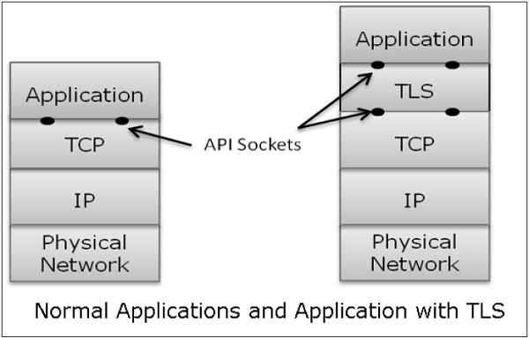
In the above diagram, although TLS technically resides between application and transport layer, from the common perspective it is a transport protocol that acts as TCP layer enhanced with security services.
TLS is designed to operate over TCP, the reliable layer 4 protocol (not on UDP protocol), to make design of TLS much simpler, because it doesn't have to worry about ‘timing out’ and ‘retransmitting lost data’. The TCP layer continues doing that as usual which serves the need of TLS.

Slide 80
Why TLS is Popular?
The reason for popularity of using a security at Transport Layer is simplicity.
Design and deployment of security at this layer does not require any change in TCP/IP protocols that are implemented in an operating system.
Only user processes and applications needs to be designed/modified which is less complex.

Slide 81
Secure Socket Layer (SSL)
Secure Socket Layer (SSL) provides security to the data that is transferred between web browser and server.
SSL encrypts the link between a web server and a browser which ensures that all data passed between them remain private and free from attack.

Slide 82
Salient Features of SSL
The salient features of SSL protocol are as follows −
SSL provides network connection security through −
Confidentiality − Information is exchanged in an encrypted form.
Authentication − Communication entities identify each other through the use of digital certificates. Web-server authentication is mandatory whereas client authentication is kept optional.
Reliability − Maintains message integrity checks.
SSL is available for all TCP applications.
Supported by almost all web browsers.
Provides ease in doing business with new online entities.
Developed for Web e-commerce

Slide 83
Architecture of SSL
SSL protocol is designed to interwork between application and transport layer as shown in the following image −

Slide 84
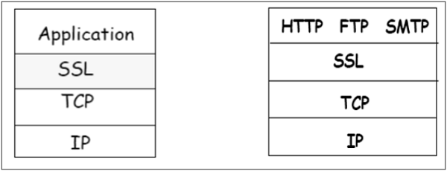
SSL itself is not a single layer protocol as depicted in the image; in fact it is composed of two sub-layers.
Lower sub-layer comprises of the one component of SSL protocol called as SSL Record Protocol. This component provides integrity and confidentiality services.
Upper sub-layer comprises of three SSL-related protocol components and an application protocol. Application component provides the information transfer service between client/server interactions. Technically, it can operate on top of SSL layer as well. Three SSL related protocol components are −
SSL Handshake Protocol
Change Cipher Spec Protocol
Alert Protocol.
These three protocols manage all of SSL message exchanges

Slide 85
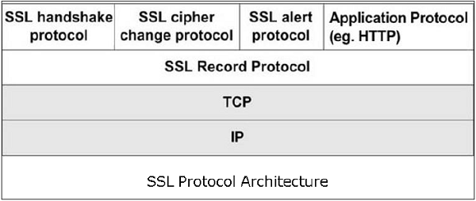

Slide 86
Functions of SSL Protocol Components
The four sub-components of the SSL protocol handle various tasks for secure communication between the client machine and the server.
Record Protocol
The record layer formats the upper layer protocol messages.
It fragments the data into manageable blocks (max length 16 KB). It optionally compresses the data.
Encrypts the data.
Provides a header for each message and a hash (Message Authentication Code (MAC)) at the end.
Hands over the formatted blocks to TCP layer for transmission.

Slide 87
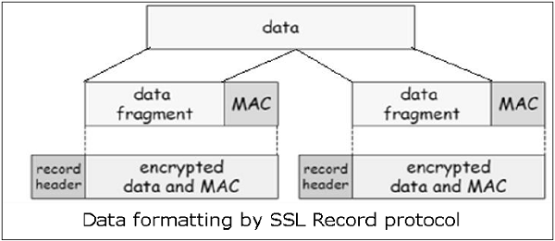
SSL Handshake Protocol
It is the most complex part of SSL. It is invoked before any application data is transmitted. It creates SSL sessions between the client and the server.
Establishment of session involves Server authentication, Key and algorithm negotiation, Establishing keys and Client authentication (optional).
A session is identified by unique set of cryptographic security parameters.
Multiple secure TCP connections between a client and a server can share the same session.
Handshake protocol actions through four phases.

Slide 88
ChangeCipherSpec Protocol
Simplest part of SSL protocol. It comprises of a single message exchanged between two communicating entities, the client and the server.
As each entity sends the ChangeCipherSpec message, it changes its side of the connection into the secure state as agreed upon.
The cipher parameters pending state is copied into the current state.
Exchange of this Message indicates all future data exchanges are encrypted and integrity is protected.
SSL Alert Protocol
This protocol is used to report errors – such as unexpected message, bad record MAC, security parameters negotiation failed, etc.
It is also used for other purposes – such as notify closure of the TCP connection, notify receipt of bad or unknown certificate, etc

Slide 89
Security in Network Layer
The popular framework developed for ensuring security at network layer is Internet Protocol Security (IPsec).
Features of Ipsec
IPsec is not designed to work only with TCP as a transport protocol. It works with UDP as well as any other protocol above IP such as ICMP, OSPF etc.
IPsec protects the entire packet presented to IP layer including higher layer headers.
Since higher layer headers are hidden which carry port number, traffic analysis is more difficult.
IPsec works from one network entity to another network entity.
Tough widely used to provide secure communication between network entities, IPsec can provide host-to-host security as well.
The most common use of IPsec is to provide a Virtual Private Network (VPN), either between two locations (gateway-to-gateway) or between a remote user and an enterprise network (host-to-gateway).

Slide 90
Security Functions
The important security functions provided by the IPsec are as follows −
Confidentiality
Enables communicating nodes to encrypt messages.
Prevents eavesdropping by third parties.
Origin authentication and data integrity.
Provides assurance that a received packet was actually transmitted by the party identified as the source in the packet header.
Confirms that the packet has not been altered
Key management.
Allows secure exchange of keys.
Protection against certain types of security attacks, such as replay attacks.

Slide 91
Operations Within IPsec
The IPsec suite can be considered to have two separate operations providing a complete set of security services.
These two operations are IPsec Communication and Internet Key Exchange.

Slide 92
IPsec Communication
It is typically associated with standard IPsec functionality. It involves encapsulation, encryption, and hashing the IP datagrams and handling all packet processes.
Internet Key Exchange.
IKE is responsible for creation of keys for IPsec and providing authentication during key establishment process.

Slide 93
IPsec Communication Modes
IPsec Communication has two modes of functioning
Transport mode
Tunnel modes.

Slide 94
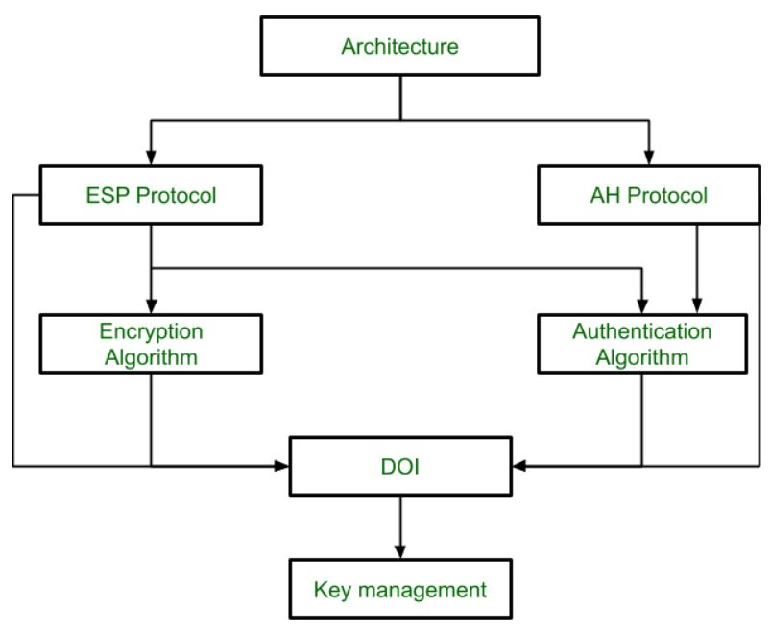
IPSec Architecture

Slide 95
IPsec Protocols
IPsec uses the security protocols to provide desired security services.
Security associations between the communicating entities are established and maintained by the security protocol used.
There are two security protocols defined by IPsec — Authentication Header (AH) and Encapsulating Security Payload (ESP).

Slide 96
Authentication Header
The AH protocol provides service of data integrity and origin authentication. It optionally provides for message replay resistance. However, it does not provide any form of confidentiality.
Encapsulation Security Protocol (ESP)
ESP provides security services such as confidentiality, integrity, origin authentication, and optional replay resistance. The set of services provided depends on options selected at the time of Security Association (SA) establishment.

